Slide 1

Heap meamory manger
Presented by/Mahmoud Zayed

Slide 2
Memory process layeout
Kernel (mapped into process virtual memory, but not accessible to program)
Argv
, environ
Stack (grows downwards)
(unallocated memory)
Heap (grows upwards)
Uninitialized data (bss)
Initialized data
Text (program code)

Slide 3

Heap memory
Many system programs need to be able to allocate extra memory for dynamic data structures (e.g., linked lists and binary trees), whose size depends on information that is available only at run time, process can allocate memory by increasing the size of the heap, a variable size segment of contiguous virtual memory that begins just after the uninitialized data segment of a process and grows and shrinks as memory is allocated and freed.
The limit of heap memory section is referred by program break .
To save memory space kernel increase heap memory by moving as process need program break , it moves program break with a large space to avoide calling system call sbrk or brk many times.

Slide 4

project goals
We need to mange the heap of the process by implementing our malloc and free functions.
Another important goal in this code is to manage size of the heap and controlling the moving of the program break which determine the limit of the heap by increasing the size of the heap when we need more memory or by decreasing size of heap when we deallocate blocks.
After implementing the code we need to test it well in deffirent cases to make sure that is working well.
Finaly I will try to built the code as a shared library and replace it with GNU libc and trying to run some process like bash , ls , vim …. .

Slide 5

Ideas of my Implementation
The returned block size is not only the needed size from the process but we allocate an extra size to hold the meta data of this block . Meta data helped me after that to trace the allocated blocks and in managing my heap.
I think in tow ways to implement my allocated and free block:
First idea : I will use a double linked list for freed blocks only and when we want to allocate a block we remove it from user ,I had been interested in this idea at first and decided to use it but faced I problem “let us say that was not found now” this problem was how I will allocate the meta data from the area of the block.
Second idea : is to implement a single linked list for free and allocated blocks with marking the allocated block with a flag to.
I used second implementation in my project.

Slide 6
The code implementation
This animation simplify how my design is working.
next
flag
size
fee
allocated
.BSS
Allocated block
next
flag
size
allocated
size
free
freed
next
flag
freed

Slide 7
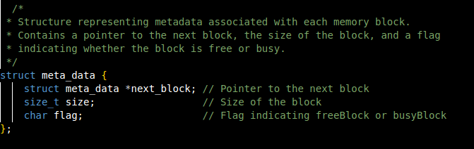
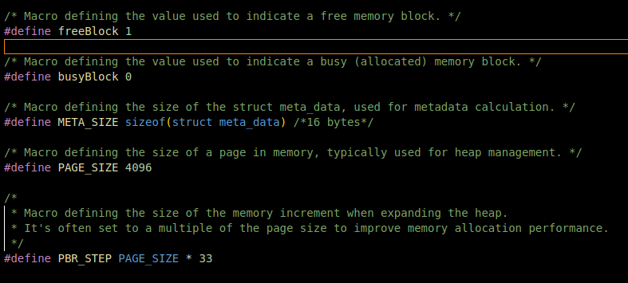
Code parts
I used a single linked list to enable me for managing the heap
I preferred to use a single list to save size of meta data from 32byte to 24 byte.

Slide 8

code
Then I initialize a global pointer of type of meta data to point the first location in my heap as each time I need to allocate or free I will start from it , I called this global pointer “free_list = NULL” and initialized it to null.
In my code I implemented my_malloc() and my_free() to use them instead of malloc() and free() functions which provided by glibc library.
But to implement those functions I used other functions to help me and make the code simplify and more readable.
Those helped functions are :

Slide 9
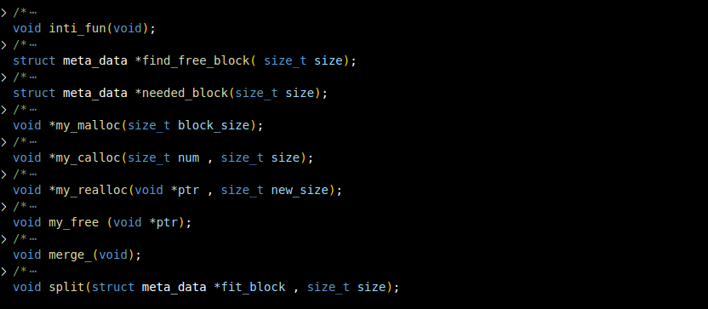
code

Slide 10
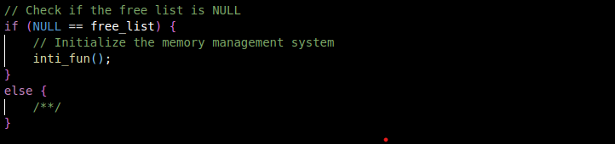
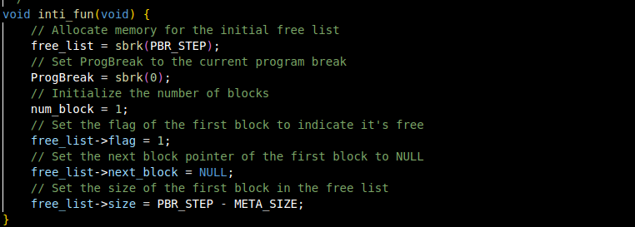
Code : init_function.
When I use malloc I check if free_list ptr is null or not if it’s free I called init_function to initialize my heap memory:
If the condition is true I called init_function.

Slide 11

Code : find_freeblock fun
I used this function with malloc function to find a suitable free block for the needed block to be allocated .
First : I initialized a current_ptr points to the start of the heap list , and initialize a local variable I used it to trace if I found a suitable block or not as flow:
If I found a suitable block I set check variable to one and get out loop , else I keep it to zero.
When I get out the first loop I check the check var.
Then we have two states
1-I didn’t find a suitable block.
2-I found a suitable block.

Slide 12
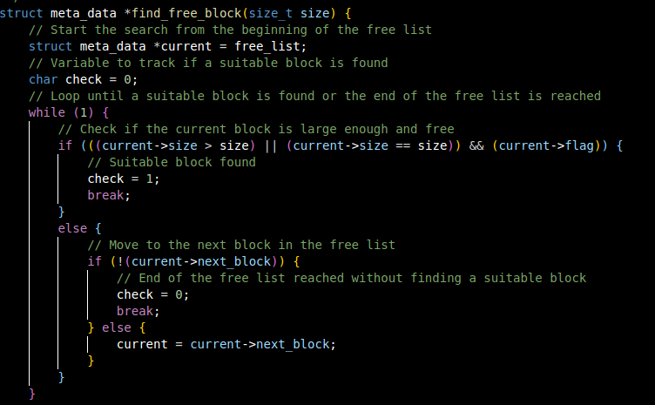
Code : find_freeblock fun

Slide 13
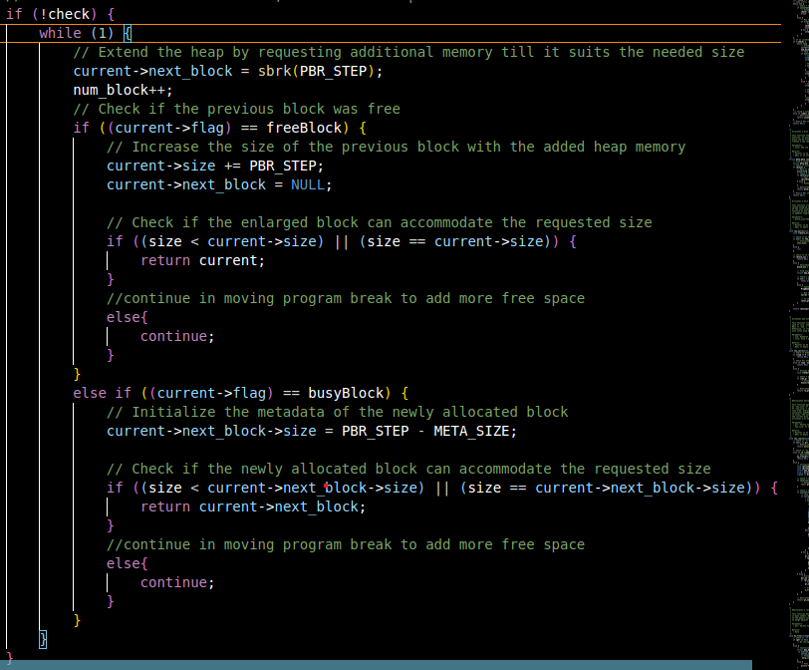
Code : find_freeblock fun

Slide 14
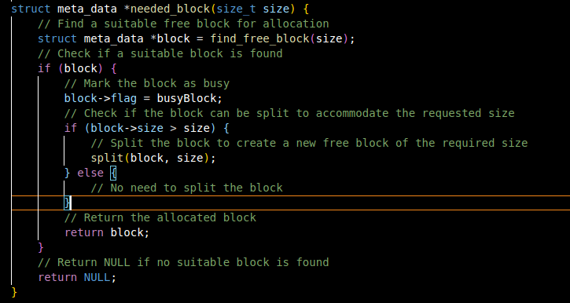
Code : needed_block fun
After returning from the find_needed_block function
I get a suitable free block but it may have a size large
than the needed size so I need to call split function
which split the suitable block into two blocks one with
the needed size and the other with a size equal to the
remaining size after removing meta data size as shown in the
code of split function .

Slide 15
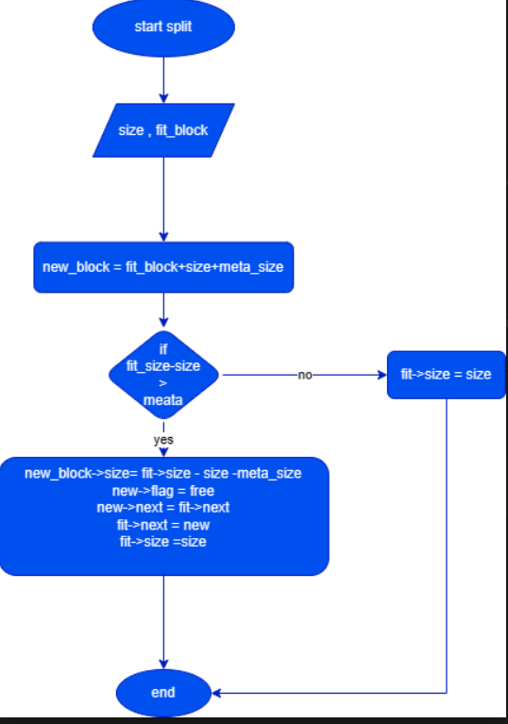
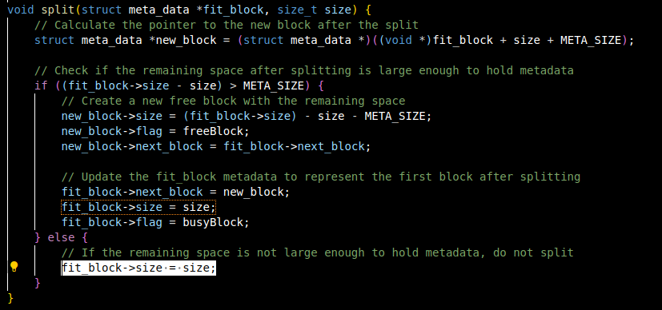
Code : split function
Split function split the over size block into two blocks and link them in the free_list.

Slide 16
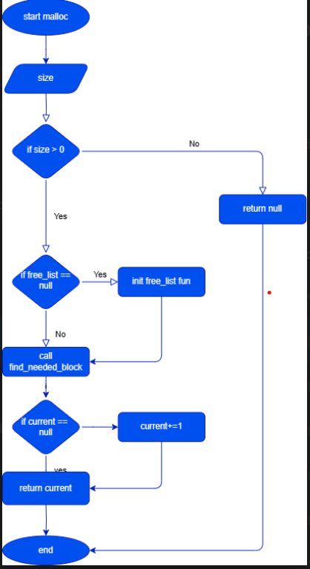
My_Malloc function
User or process use my_malloc function to allocate
blocks from the heap.
My_malloc call NEEDED_BLOCK_FUN() to find a suitable block with needed size if it succeed to find a block it return an address for it , if it failed it returns a null pointer.

Slide 17
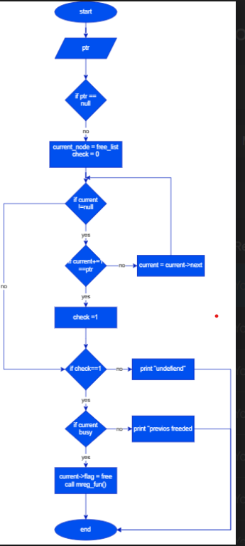
Code: My_free function
Free function is used for freeing previous allocated block after process
doesn’t need this block any more.
In my free function I provided a function to merge any number of
free blocks behind each other.
If the last block is free and it’s size is more than 132kelo byte I will
call sbrk system call to lower the program break to save heap segment.
In my implementation I free a block by setting it’s flag to one.

Slide 18
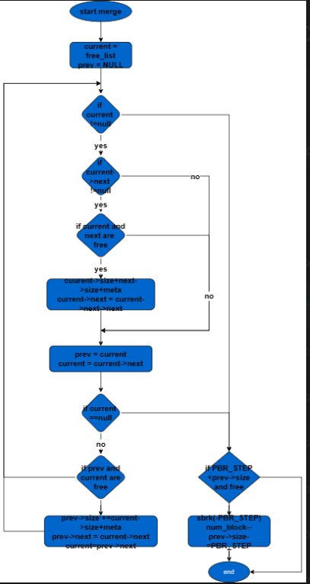
Code :merge function
I used merge function to merge any two blocks behind each other
And lowering program break.
If there is more than one block behind each other MERGE_FUN() can merge
Them into a single block.
I also used merge function to lower program break which determine the
Limit if the heap

Slide 19
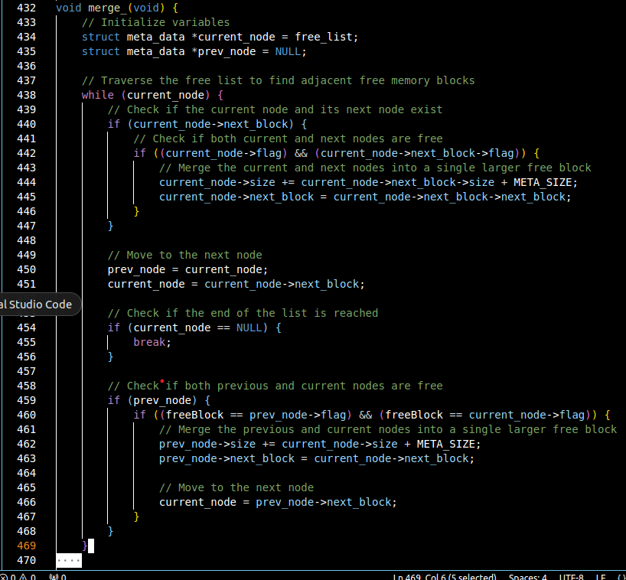
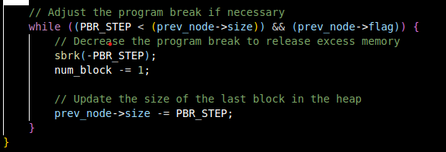
Code : merge

Slide 20

Calloc & realloc functions
After I tried different test cases for my code and make sure that is work will I tried to compile my code as a shared library and use it to run some linux programs like vim , bash , cat , less ….. .
But when I replace my own malloc and free I found that I need to implement realloc and calloc and cover they cases.
I implement them depends on my malloc and free functions.
Let’s see

Slide 21
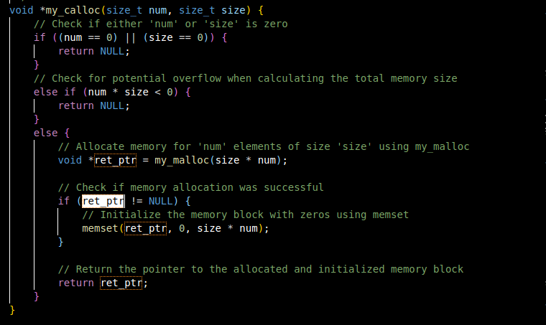
Calloc function

Slide 22
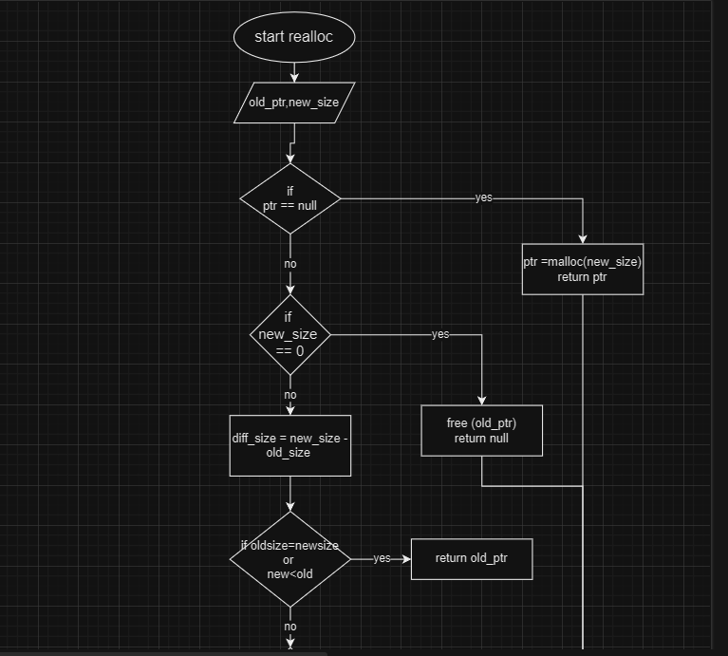
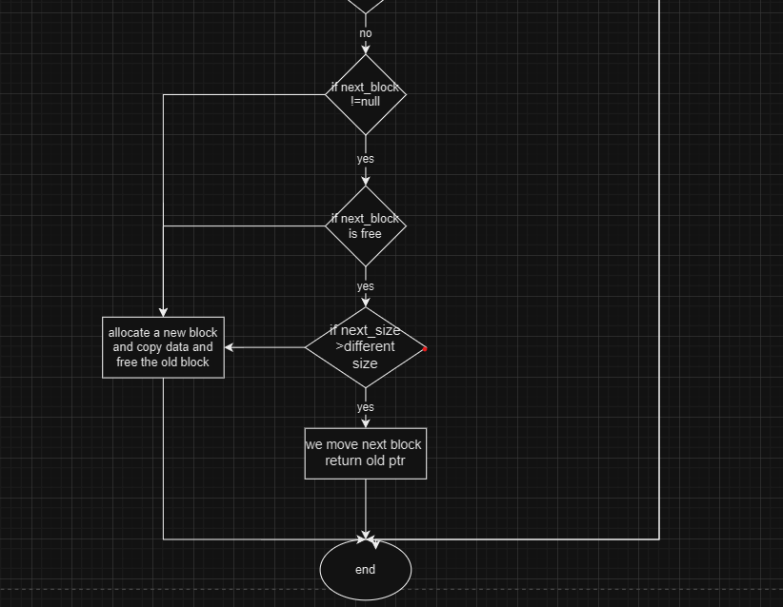
Realloc function

Slide 23

Code testing
I test my code by running a program which allocate a large number of blocks behind each other and then free them.
Another test I run a script which allocate and free a number of blocks with different sizes in a random sequence.
After I make sure that all blocks are allocated and free with a right behavior I go to run some Linux programs like bash , vim , cat , grep , ls and so on with my code by compiling it as a shared library.

Slide 24
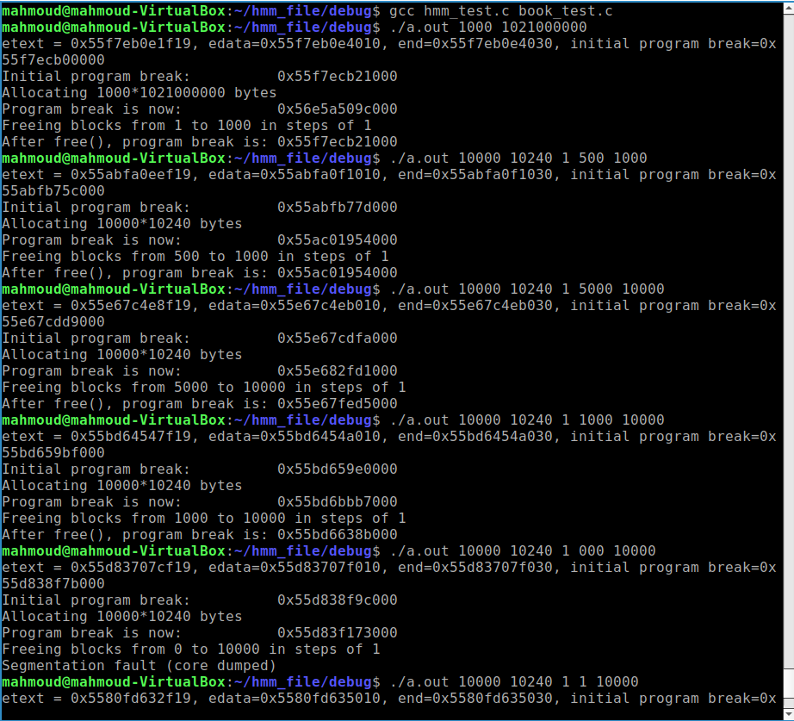
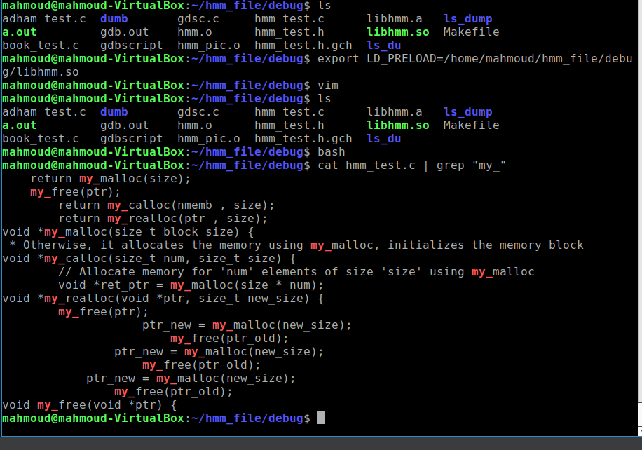
Code testing

Slide 25
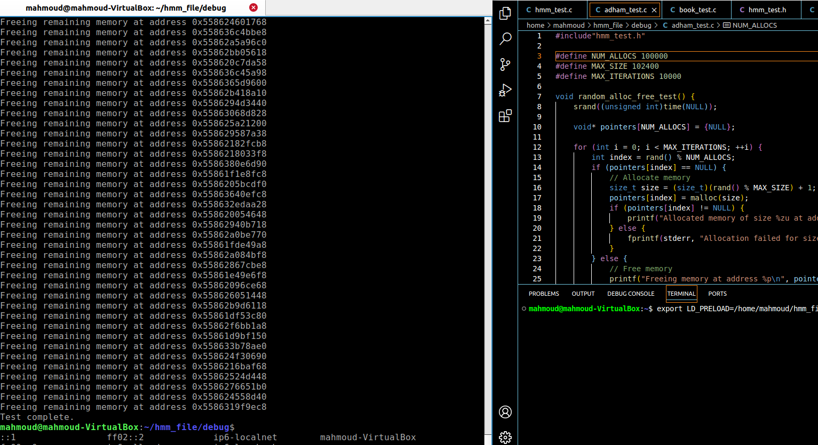
Code testing

Slide 26
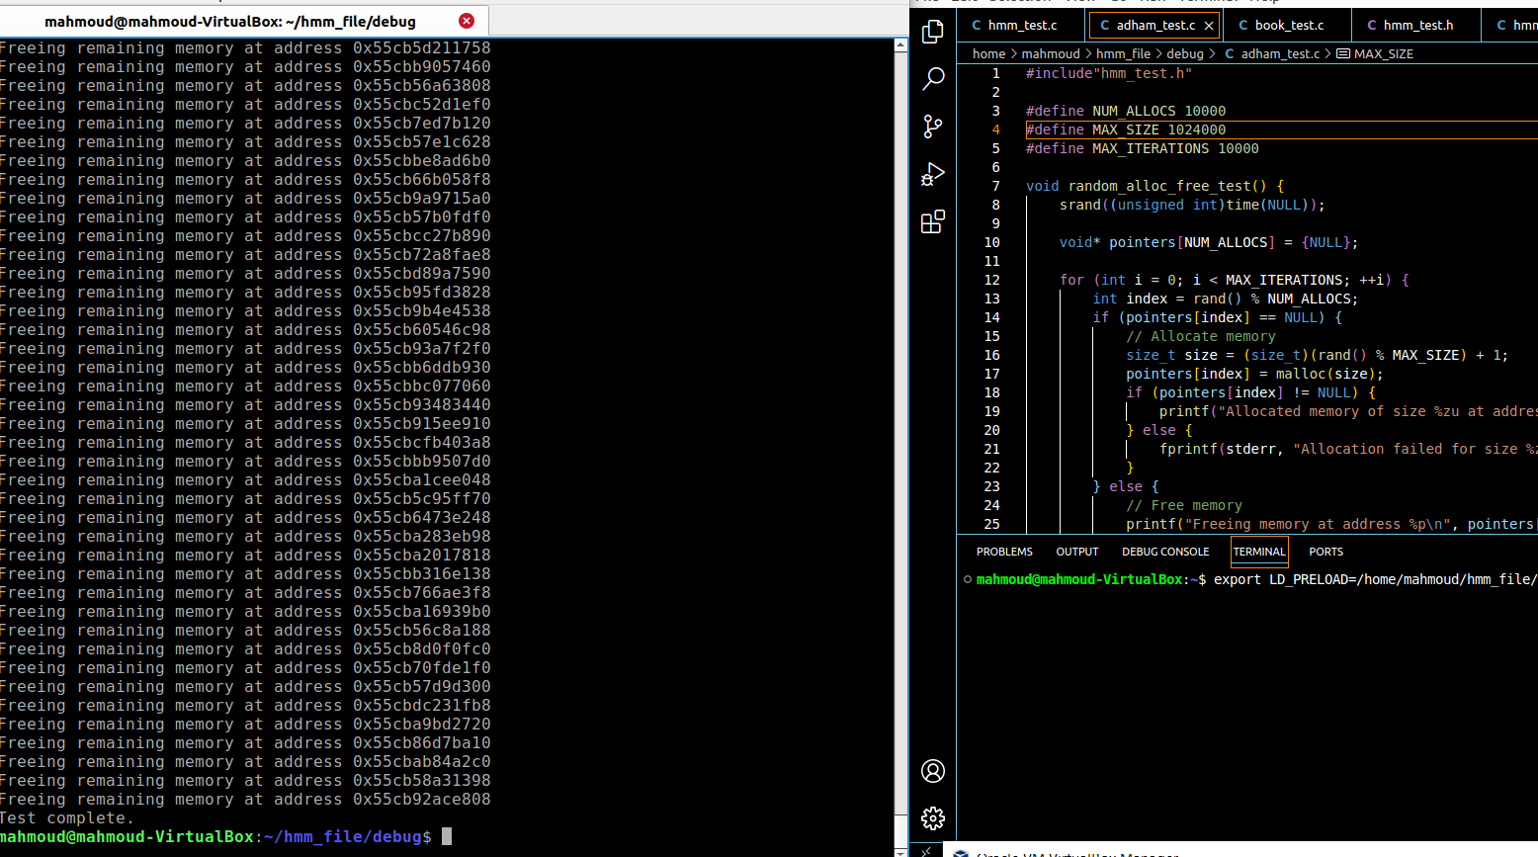
Code testing

Slide 27

Some links and texts helped me in my implementation
The Linux Programming Interface A Linux and UNIX® System Programming Handbook by Michael KerrisK.
https://arjunsreedharan.org/post/148675821737/memory-allocators-101-write-a-simple-memory
https://github.com/practical-tutorials/project-based-learning

Slide 28

Eng \ Reda Maherr

